Slide 1
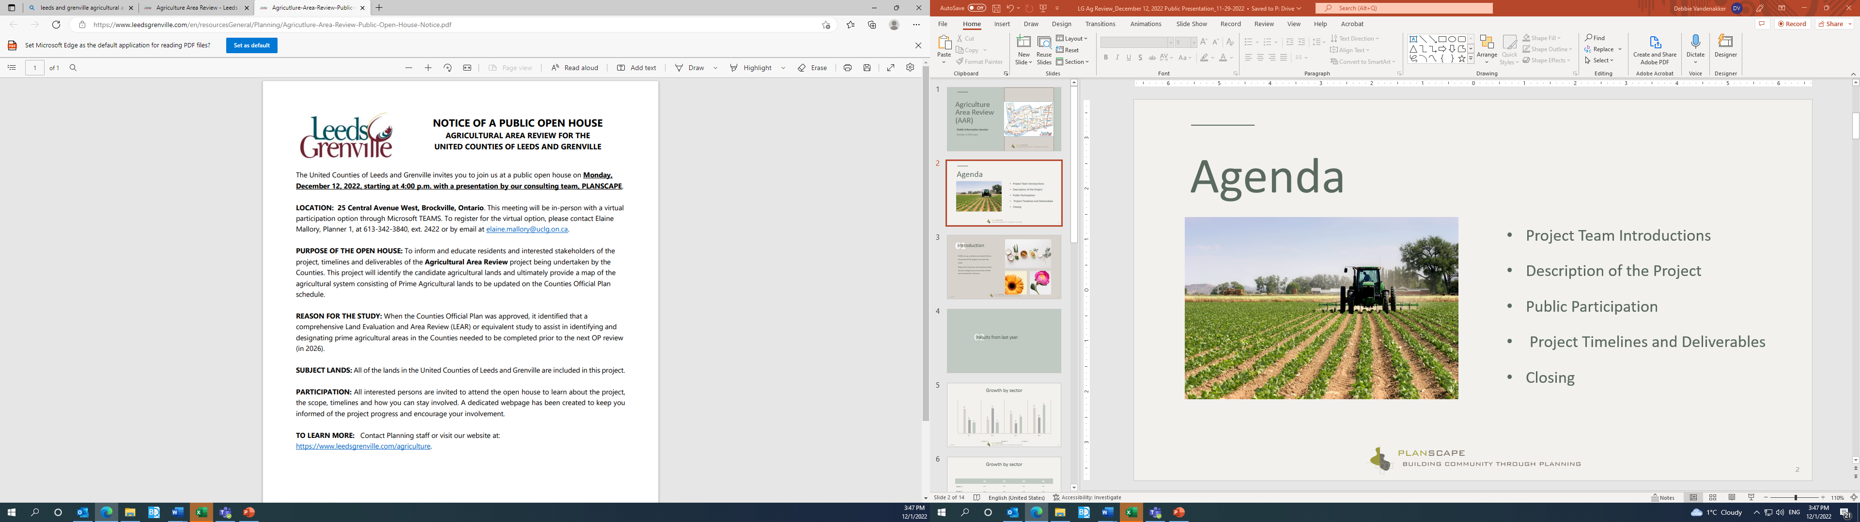
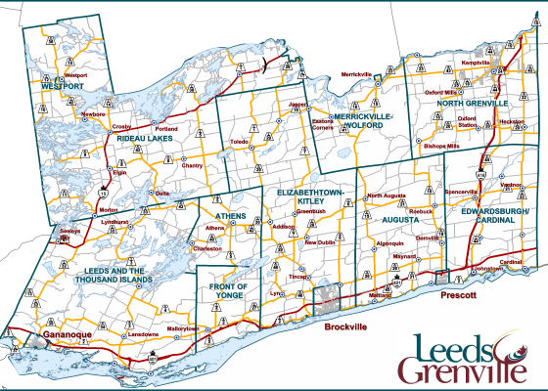

Planning Advisory Committee (PAC)
Additional Consultation and Revised Draft Agricultural System Mapping
February 7, 2024 at 9:00a.m.
Notes:
Line spacing + Page numbers

Slide 2
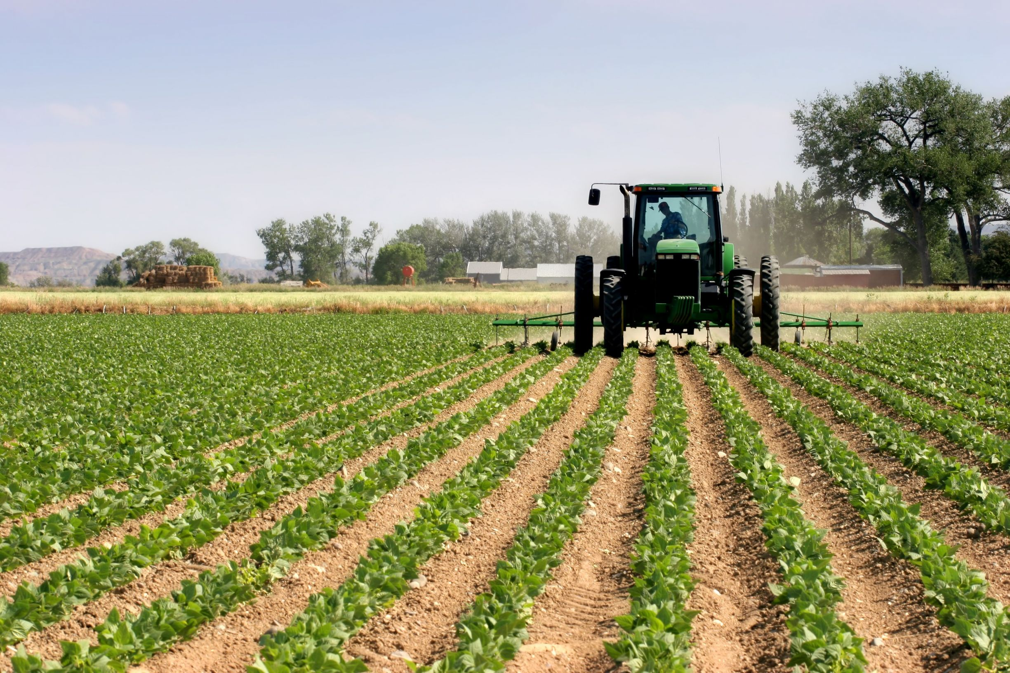
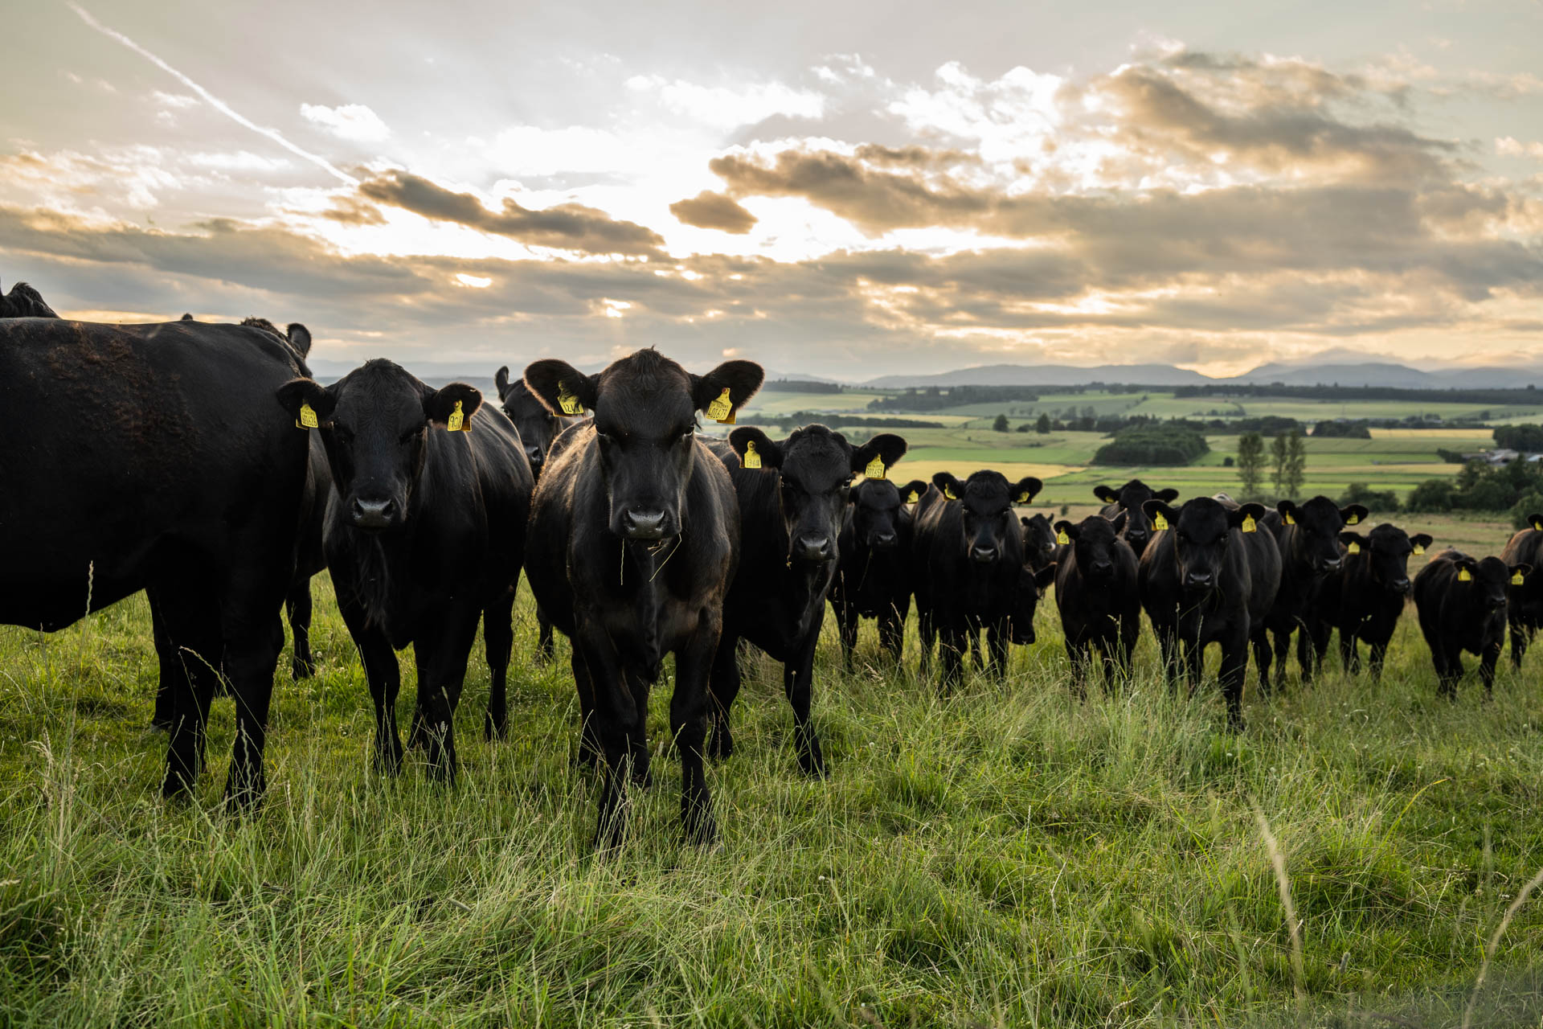
Agenda
Project Review
Additional Consultation
Revised Draft Agricultural System Map
Statistical System Summary
Final Project Steps

Slide 3

Project Purpose
To satisfy the provincial requirement to identify and designate prime agricultural areas in the Counties OP in advance of the next OP review through a modified LEAR process.
The result of a LEAR process is a map of the County agricultural system that represents lands that are viable for agriculture and emphasize the importance of creating a system wherever possible.
The product of the finished project is an update to Schedule A of the Official Plan with a new “Agricultural Areas” designation and an Official Plan Amendment updating the County policies.

Slide 4
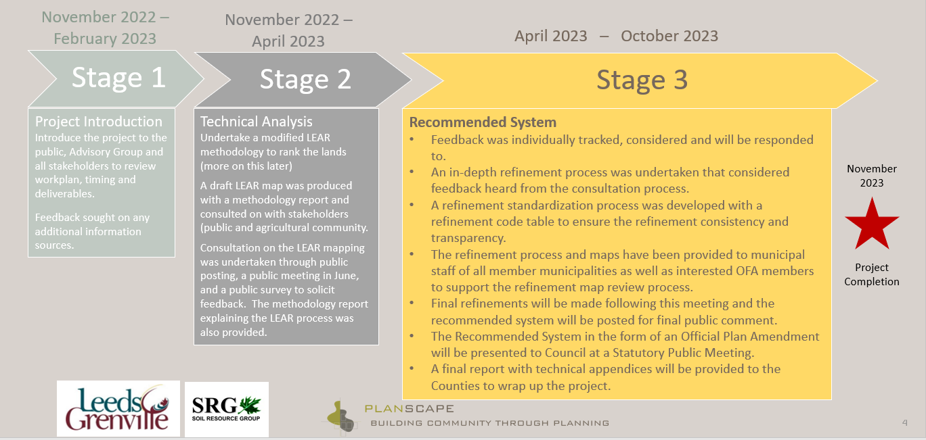
Adjusted Project Schedule
Added project stage
October 2023 – February 2024
Stage 4
Additional Individual Consultation
Individual letters to residents impacted by a recommended change in designation. Tracking of all additional refinements, creation of revised recommended agricultural system map .
Individual responses, local area municipal meetings and PAC update.
Update of recommended system map and draft Official Plan Amendment.
Draft OPA complete.
March / April 2024
Project Completion (Notice of and hosting of public meeting / Council endorsement of system and approval of OPA)

Slide 5
Consultation Process
Continuous and responsive consultation has taken place throughout the project through a coordinated effort with Counties staff and Planscape.
The following formal meetings have taken place to date:
  December 12, 2022 Public Open House and Technical Advisory Group (TAG)
  January 4, 2023 Planning Advisory Committee (PAC)
  March 3, 2023 Grenville Federation of Agriculture
  March 24, 2023 Leeds Federation of Agriculture
  May 11, 2023 TAG
  May 25, 2023 PAC
  June 21, 2023 Public Information Session
  June 22, 2023 Site Visits with interested parties
  August 1 – 16, 2023 Distribution of refined maps to local municipalities
  August 23, 2023 Leeds Federation of Agriculture
  August 29, 2023 Grenville Federation of Agriculture (cancelled due to lack of interest/availability)
  August 31, 2023 TAG
  September 6, 2023 PAC (direction provided for additional public consultation)
  September 21, 2023 Counties Council endorsement of staff approach to additional public consultation
    Details contained in next slide
  February 6, 2024 – Local Area Consultation Meetings (Augusta, Edwardsburgh Cardinal and North Grenville)
  February 7, 2024 Planning Advisory Committee (PAC) and Local Area Consultation Meeting (Rideau Lakes)

Slide 6
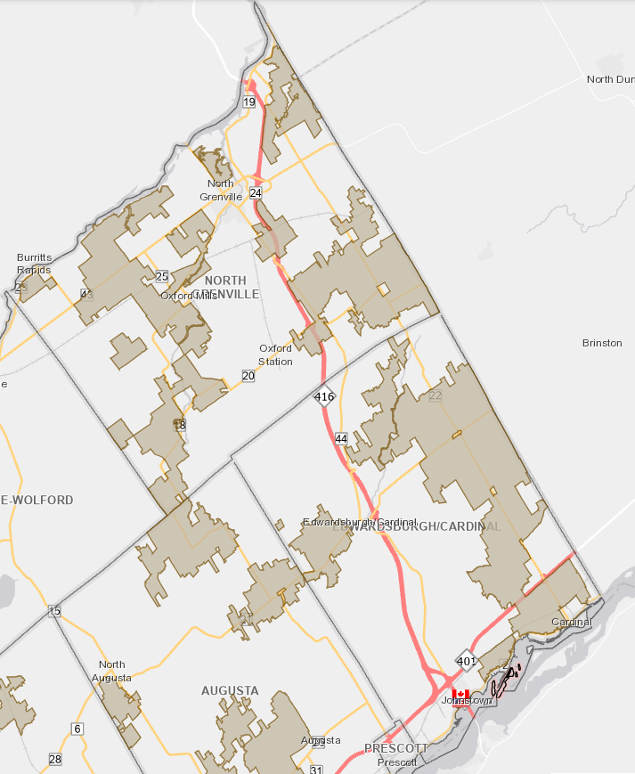
Individual Consultations
Early October 2023 – information packages sent to individual property owners
Early October 2023 - Project website updated
  Over 2000 information packages were sent out
  276 residents contacted staff and the consulting team because of the mail-out
  Refinements based on local area knowledge from these conversations was made where appropriate for the integrity of the recommended agricultural system
  It is estimated that 96% of property owners that contacted staff and the consulting team appeared to be satisfied by these interactions
Notes:
Early October 2023 – information packages sent to individual property owners that were potentially impacted by the draft recommended system (either added to it or removed from the existing designation)
Early October 2023 - Project website updated with information and an interactive map whereby residents could search their property, the underlying 100-acre block LEAR scores, the refinements to the system to date and what the existing system looks like today.
Over 2000 information packages were sent out. The package included a letter with all contact information, a map of the existing and recommended system, background information on the study and a frequently asked questions sheet.
276 residents contacted staff and the consulting team because of the mail-out.
Refinements based on local area knowledge from these conversations was made where appropriate for the integrity of the recommended agricultural system.
It is estimated that 96% of property owners that contacted staff and the consulting team appeared to be satisfied by these interactions.
From Debbie’s Records (in case asked where the majority of comments came from):
25 in Rideau Lakes
20 in Leeds and 1000 Islands
3 in Front of Yonge
6 in Athens (1 from municipal and one from OFA in this area)
28 in Elizabethtown Kitley
7 in Merrickville-Wolford
20 in Augusta
60 in North Grenville
34 in Edwardsburg Cardinal

Slide 7
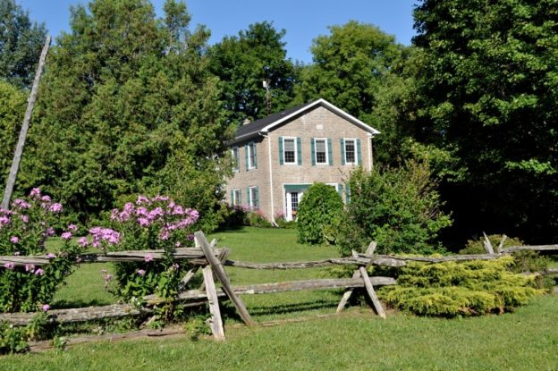
Individual Consultations continued
Frequently heard issues included:
  Will the change impact my taxes?
  Can I still build a dwelling on my vacant land?
  Can I still build an accessory dwelling?
  Will this impact my ability to get a mortgage (insurance)?
  Will this impact the value of my property?
  Will this impact my ability to sever?
Notes:
The vast majority of concern was related to severance potential. Residents were advised what the agricultural designation would mean in terms of limiting the ability to sever and were directed to their local area municipality for additional process specifics.
We understand the importance of the severance issue to residents. Much care and consideration was used in these conversations and while the desire to sever land cannot be a justification for removing land from the recommended system, through the course of conversations, local area knowledge of soil quality and surrounding land use was evaluated on a site by site basis to determine if the lands could be excluded or should remain included as appropriate.
Mortgage Issue:
While not a land use planning issue, staff checked with various sources, including a legal expert in real estate/mortgages, and changing the land use designation on a property from rural to agricultural (or vice versa) does not have an impact on whether or not a lender should deem it adequate for whatever loan is under consideration. Most lenders will not lend on the security of vacant land, regardless of zoning. Typically, the value of the loan relates to the home and 2 to 3 acres surrounding the home.
It is also understood there may be a reluctance to insure agriculturally zoned lands due to fear the mortgagee may invoke the “Farm Debt Mediation Act” (FDMA). This Act exists to provide farmers with a period of time to demonstrate long-term viability of the farm to creditors. It requires that the farmer be farming for “commercial purposes” and can be on rural and agricultural designations.

Slide 8
Refined Draft Recommended System
Notes:
The only changes to this system may be from the local area consultation meetings should new information be presented.
This represents the culmination of the original system based on the LEAR methodology, the first round of refinements to eliminate isolated areas and confirm boundaries, then the second round of refinements based on the additional individual consultations.
This system represents a comprehensive agricultural system that will protect the agricultural resources of the Counties in the long-term.

Slide 9
Statistical Summary of Recommended System
 | Removed From Existing Prime |  | Added To Existing Prime |  | Not Added To Prime (scored 60 but refined out) |  | Removed from Original Recommended System |  | Added to Original Recommended System |  | Total Area in Refined Recommended System
 | Hectares | Acres | Hectares | Acres | Hectares | Acres | Hectares | Acres | Hectares | Acres | Hectares | Acres
North Grenville | 201.71 | 498.40 | 1,902.07 | 4,700.23 | 4,049.04 | 10,005.30 | 1,541.33 | 3,808.67 | 25.63 | 63.35 | 11,264.56 | 27,835.29
Edwardsburgh Cardinal | 597.39 | 1,476.19 | 2,897.66 | 7,160.27 | 2,622.55 | 6,480.46 | 83.59 | 206.54 | 80.33 | 198.52 | 9,403.54 | 23,236.65
Augusta | 330.52 | 816.69 | 2,748.51 | 6,791.62 | 4,490.17 | 11,095.27 | 821.85 | 2,030.82 | 209.14 | 516.81 | 5,876.93 | 14,522.22
Front of Yonge |  |  | 598.31 | 1,478.48 | 685.70 | 1,694.39 | 9.89 | 24.45 | 66.51 | 164.34 | 659.25 | 1,629.05
Athens | 96.41 | 238.24 | 647.75 | 1,600.61 | 759.35 | 1,876.42 | 62.26 | 153.85 | 322.52 | 796.94 | 2,424.12 | 5,990.13
Elizabethtown-Kitley | 752.59 | 1,859.80 | 3,141.88 | 7,763.99 | 4,281.39 | 10,579.80 | 285.45 | 705.40 | 253.85 | 627.26 | 8,827.82 | 21,814.00
Merrickville-Wolford | 442.06 | 1,092.31 | 442.89 | 1,094.46 | 1,255.35 | 3,102.06 | 14.48 | 35.83 | 24.25 | 59.93 | 3,787.62 | 9,359.42
Leeds & 1000 Islands | 225.73 | 557.81 | 3,222.32 | 7,962.43 | 5,118.02 | 12,646.90 | 203.34 | 502.44 | 141.81 | 350.42 | 10,655.27 | 26,329.76
Rideau Lakes | 276.48 | 683.20 | 5,356.54 | 13,236.44 | 5,602.97 | 13,845.24 | 507.92 | 1,255.13 | 276.50 | 683.23 | 7,871.76 | 19,451.54
TOTALS: | 2,922.89 | 7,222.64 | 20,957.93 | 51,788.53 | 28,864.54 | 71,325.86 | 3,530.11 | 8,723.13 | 1,400.54 | 3,460.80 | 60,770.87 | 150,168.06
Original Draft Recommended System based on LEAR and first round refinements
Individual consultation refinements
Current / Draft Final Agricultural Area Designation

Slide 10
Statistical Summary Continued
Municipality | ORIGINAL Recommended System (prior to individual consultation refinements) |  | Refined Draft Recommended Agricultural System (after individual consultation refinements) |  | Area Result of Individual Consultation Refinements
 | Hectares | Acres | Hectares | Acres | Hectares | Acres
North Grenville | 12,771.97 | 31,560.18 | 11,264.56 | 27,835.29 | -1,507.41 | -3,724.89
Edwardsburgh Cardinal | 9,443.93 | 23,336.44 | 9,403.54 | 23,236.65 | -40.39 | -99.79
Augusta | 6,509.22 | 16,084.63 | 5,876.93 | 14,522.22 | -632.29 | -1,562.41
Front of Yonge | 606.37 | 1,498.37 | 659.25 | 1,629.05 | 52.88 | 130.68
Athens | 2,165.83 | 5,351.88 | 2,424.12 | 5,990.13 | 258.29 | 638.25
Elizabethtown-Kitley | 8,863.44 | 21,902.02 | 8,827.82 | 21,814.00 | -35.62 | -88.02
Merrickville-Wolford | 3,775.67 | 9,329.88 | 3,787.62 | 9,359.42 | 11.95 | 29.54
Leeds & 1000 Islands | 10,724.75 | 26,501.42 | 10,655.27 | 26,329.76 | -69.48 | -171.66
Rideau Lakes | 8,103.85 | 20,025.09 | 7,871.76 | 19,451.54 | -232.09 | -573.55
TOTALS: | 62,965.03 | 155,589.91 | 60,770.87 | 150,168.06 | -2,194.16 | -5,421.85
Total Land Area in the Counties: | 370,775.5 | 916,206.3 | Percent of Total Land Area in Recommended System: |  | 16.39%

Slide 11
Final Project Steps
Finalize Recommended Agricultural System that will be identified as the “Agricultural Area” on Schedule A of the Official Plan.
Finalize all project reporting and submit to Counties staff.
Statutory Public Meeting regarding the OPA.
Council endorsement of the system and approval of the OPA.
Agricultural Area Review Study – FINAL REPORT

Slide 12
Thank you for attending!
Please contact the project team by phone or email if you have questions, concerns or suggestions regarding this project.
Elaine Mallory, Planner 1
613-342-3840, ext. 2422
elaine.mallory@uclg.on.ca

Slide 13
Reference Slides

Slide 14
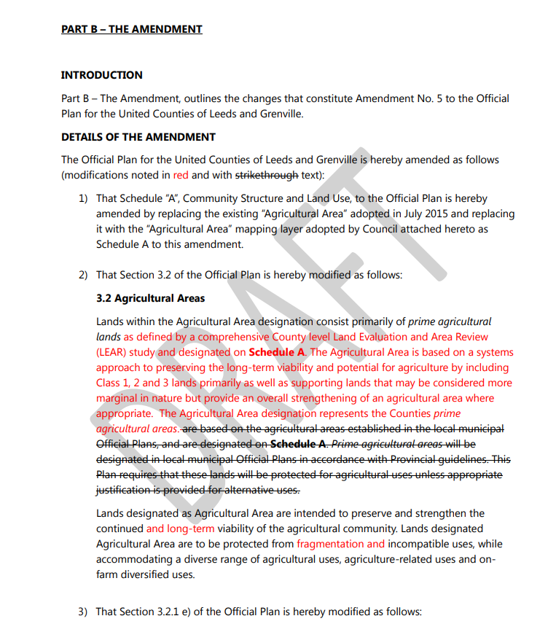

Slide 15


Slide 16
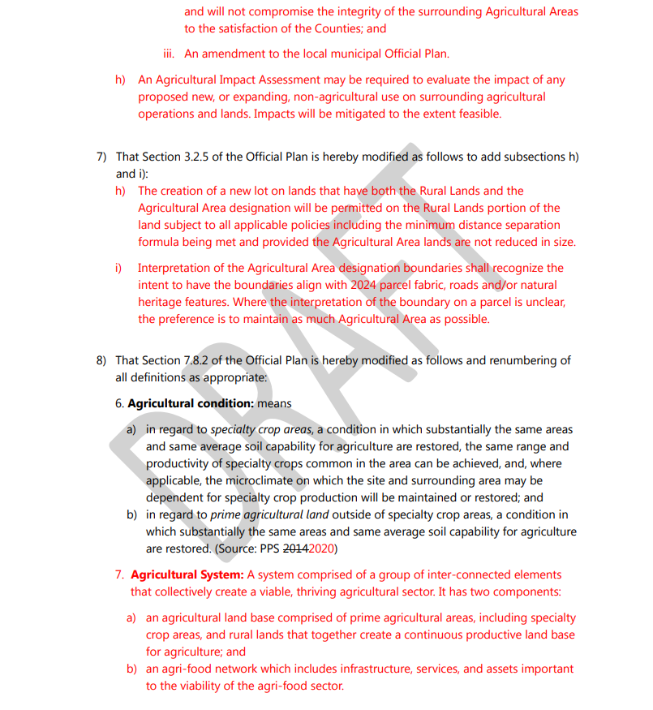

Slide 17
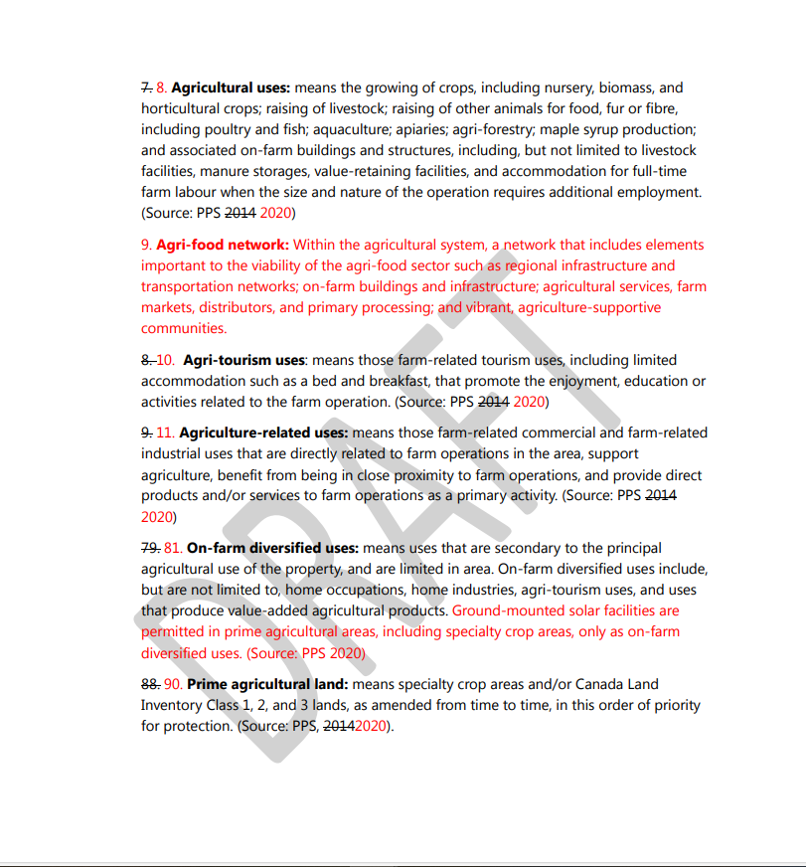

Slide 18
Refinement Procedure
A structured approach was taken for making the map refinements. The process aimed to create consistent priorities for refinement of decision-making that respects the provincial LEAR process, the fundamental integrity of an agricultural system and the feedback received throughout the process.
Factors considered for each refinement are:
Exclude isolated lands scoring 60 or more.
Include current Official Plan prime agricultural designation areas except where edge refinements clip to an identifiable boundary or to avoid an identifiable natural heritage feature that are more appropriate.
Lands that are actively farmed but scored below the 60-score threshold are generally NOT included in the prime agricultural area except where they serve to create a boundary refinement. For example, if the 60 scoring land cuts through an actively farmed field, the refinement will move the edge of the boundary to the edge of the field or property line, rather than bisect an actively farmed field.
Exclude identifiable natural heritage features such as a woodlots or wetlands where possible. Where the feature is located centrally in a contiguous agricultural area, it will be kept as part of the system (as removing it would compromise the larger system base).
Existing fragmentation has been refined out along road frontages where it is appropriate to use the road as the agricultural system boundary.
At the request of landowners, where appropriate, lands have been included that do not meet the 60-score threshold. An example of this are Community Pasture lands that do not meet the scoring threshold but provide an important component of the agricultural system. It is recognized that the LEAR methodology does not sufficiently represent the value of these lands, so they have been included where a property owner has requested that they be identified in the prime agricultural designation.

Slide 19
Refinement Codes
Refinement Code | Refinement Circumstance / Description
Ref – 1 | To extend Prime Agricultural Lands over lower scoring land to establish the agricultural system as defined by the province
Ref – 2 | To account for active production or agricultural investment that scores less than 60
Ref – 3 | To refine Prime Agricultural Lands to an identifiable boundary
Ref – 4 | To create a continuous agricultural land base across municipal jurisdictional boundaries
Ref – 5 | To reflect pre-existing non-agricultural designations or uses
Ref – 6 | To reflect land that is primarily Natural Heritage System – limited or no agricultural production is occurring
Ref – 7 | To include lands at an owner’s request
Ref – 8 | To include lands scoring greater than 60
Ref – 9 | To exclude parcels that are isolated from other agricultural lands or operations
Ref – 10 | To exclude lands with conflicting land uses
Ref – 11 | To exclude areas subject to significant fragmentation
Ref – 12 | Refinement as a result of local area municipal staff, agency, or stakeholder request
For ease of identification on the refinement maps, refinement codes were created as a labelling system.
The most applicable code is noted next to each refinement, but it is important to understand that there is very often more than one reason for the refinement.
The codes have been created to facilitate stakeholder understanding of the rationale behind the refinement but are not intended to be a complete explanation.
There is professional judgement, stakeholder input and multi-faceted criteria that were applied for every refinement in the system.

