Slide 1

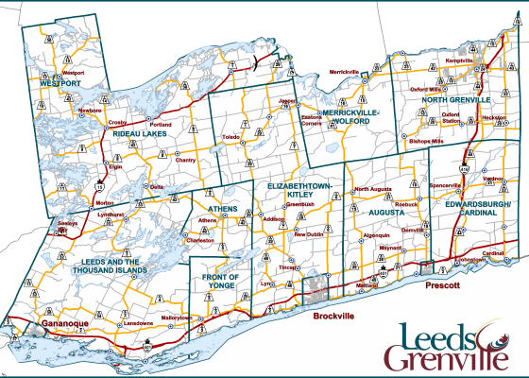

Public Meeting
Draft Land Evaluation and Area Review (LEAR) Report for Public Consultation
June 21, 2023 at 4:00pm
Notes:
Line spacing + Page numbers

Slide 2
Agenda
Where we are in the Process
Review of Draft LEAR Report
  Methodology
  Area Municipal Maps for Comment

Slide 3
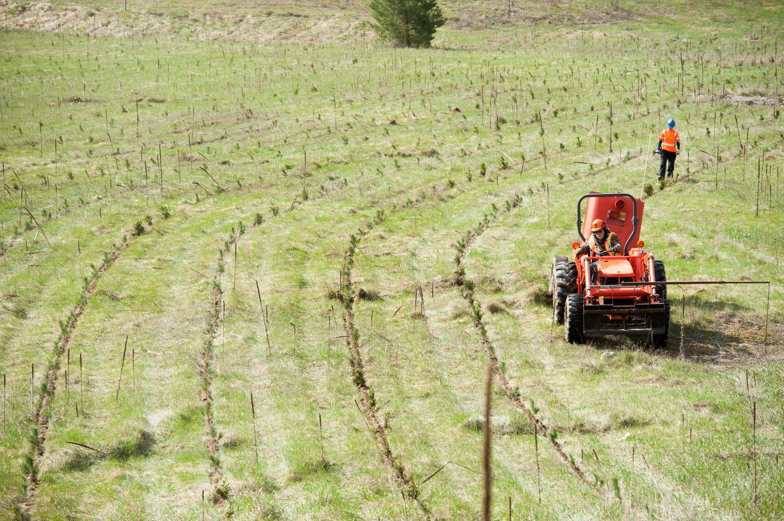
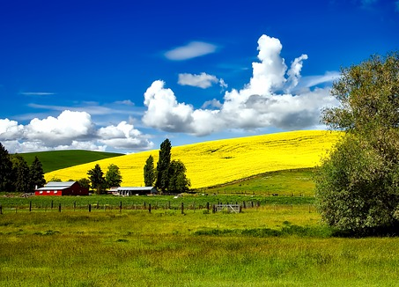
Introductions
Counties of Leeds and Grenville:
Cherie Mills, Manager of Planning Services
Elaine Mallory, Planner 1
Consultant Team:
Margaret Walton, Senior Associate – Planscape Inc.
Debbie Vandenakker, Senior Planner – Planscape Inc.
Don King, Research Agronomist – The Soil Resource Group
Greg Wall, Senior Soil Scientist – The Soil Resource Group
Don Hodgson, Pedologiest (GIS) – The Soil Resource Group

Slide 4
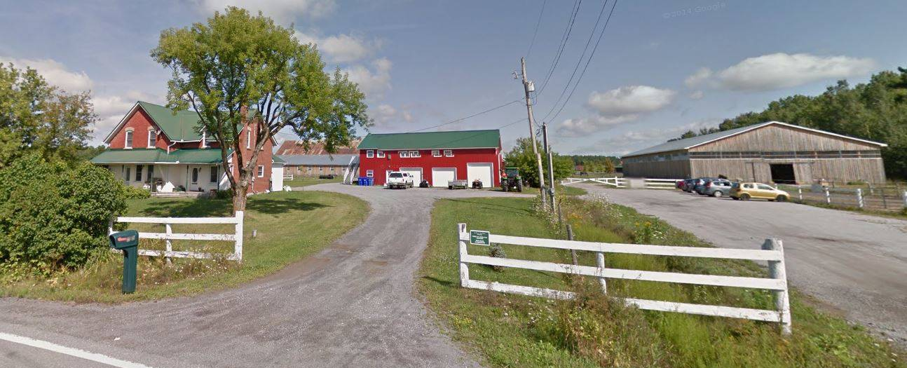
Project Description
When the Counties Official Plan was approved, it identified that a comprehensive Land Evaluation and Area Review (LEAR) or equivalent study to assist in identifying and designating prime agricultural areas in the Counties needed to be completed prior to the next OP review (in 2026).
This Agricultural Area Review is being undertaken to satisfy the provincial requirement.
This project will identify and evaluated the candidate agricultural lands and ultimately provide a map of the Counties agricultural system as the basis for an updated Counties Official Plan.

Slide 5
Where we are in the process
Stage 1
Stage 2
Stage 3
WE ARE HERE
November 2022 – February 2023
November 2022 – April 2023
April 2023 – October 2023
By November 2023
Project Introduction
Introduce the project to the public, Advisory Committee and all stakeholders to review workplan, timing and deliverables. Feedback sought on any additional information sources that should be used.
Technical Analysis
Undertake a modified LEAR methodology to rank the lands (more on this later)
A map of candidate lands will be produced from the analysis and consulted on with stakeholders.
Recommendation Report and Mapping
Review and consult on Technical LEAR
Revise mapping and consult stakeholders
Provide final report, mapping and Official Plan Amendment to Counties
Final Report, Official Plan Amendment and Schedule

Slide 6
Report
Outline

Slide 7
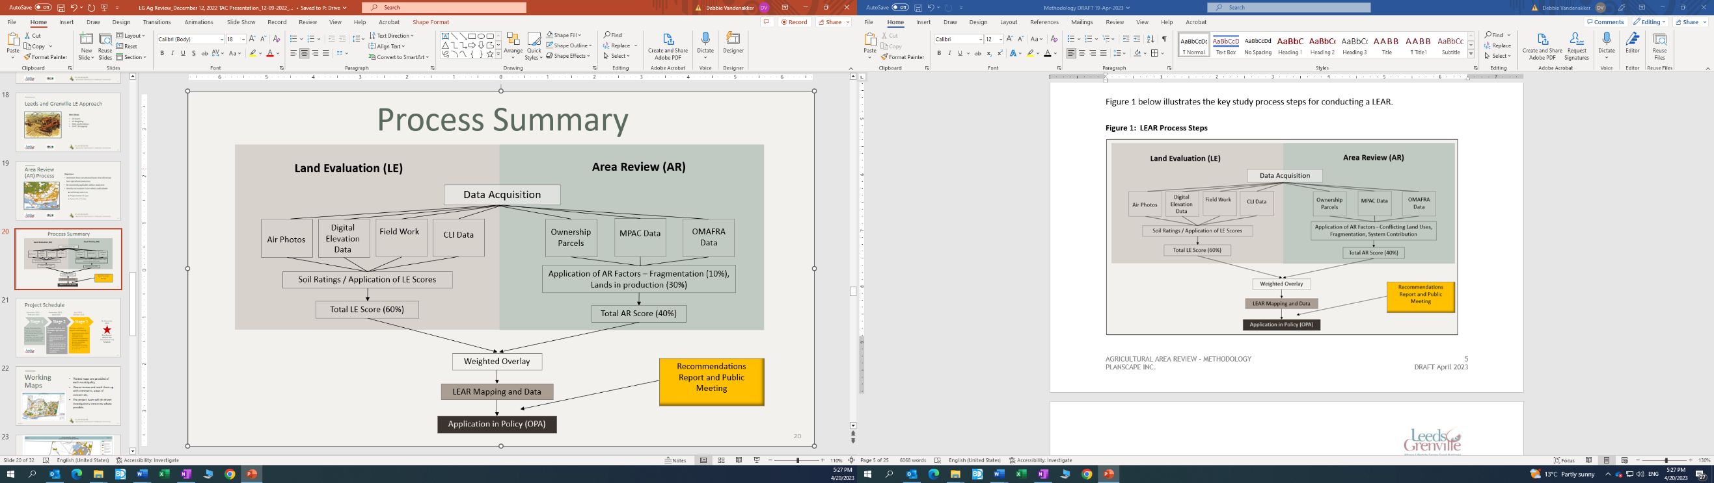
LEAR Process

Slide 8
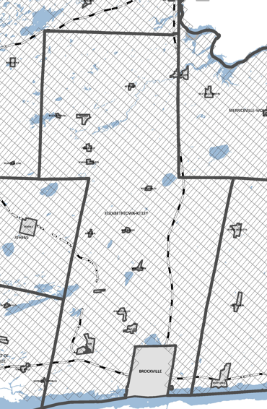
Selecting an Evaluation Unit Size
A Geographic Information System (GIS) program was used to overlay 100-acre polygons over the entirety of the geographic area of Leeds and Grenville on a north-south orientation.
Sections of the grid were removed for areas excluded from the study as noted previously.
The evaluation unit grid minus the excluded areas was defined as the area within which the LEAR was completed.

Slide 9
Calculating the LE portion of a LEAR
The seven capability classes as defined under the CLI and the point values are listed below:
CLI Class | LE Point Value
Class 1 | 1.0
Class 2 | 0.9
Class 3 | 0.8
Class 4 | 0.6
Class 5 | 0.5
Class 6 | 0.4
Class 7 | 0.0
Class | Description / Characteristics
Classes 1, 2 and 3 | Capable of sustained used for growing common field crops; all or most crops can be grown.
Class 4 | Marginal for sustained use for common field crops; choice of crops that can be grown is limited.
Class 5 | Capable of use only for permanent pasture and hay.
Class 6 | Capable of use only for unimproved pasture.
Class 7 | No capability for agriculture.
The Canada Land Inventory (CLI) system “is the recognized system in Ontario for classifying areas with mineral soils according to their inherent capability for growing common field crops”. The system does not classify soils for horticultural or other specialty crops.

Slide 10
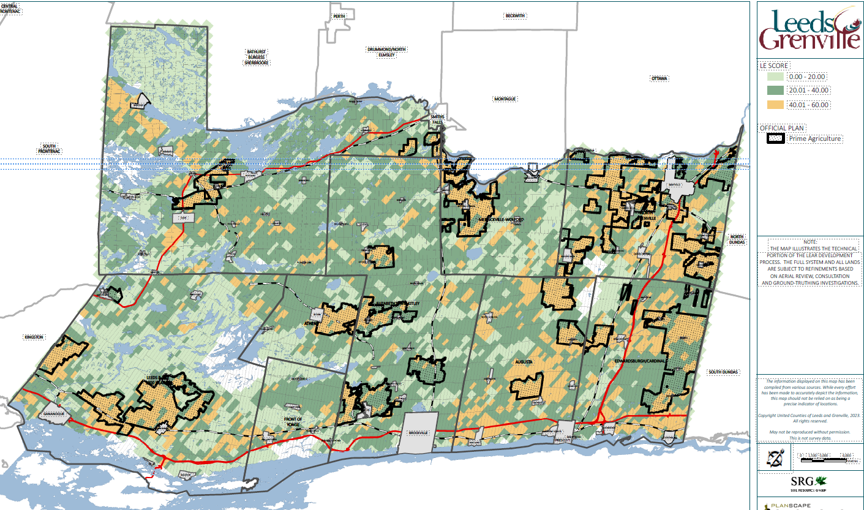
The LE portion LEAR Map
Notes:
About 30% of the lands in the Counties are Class 1 through 3.

Slide 11
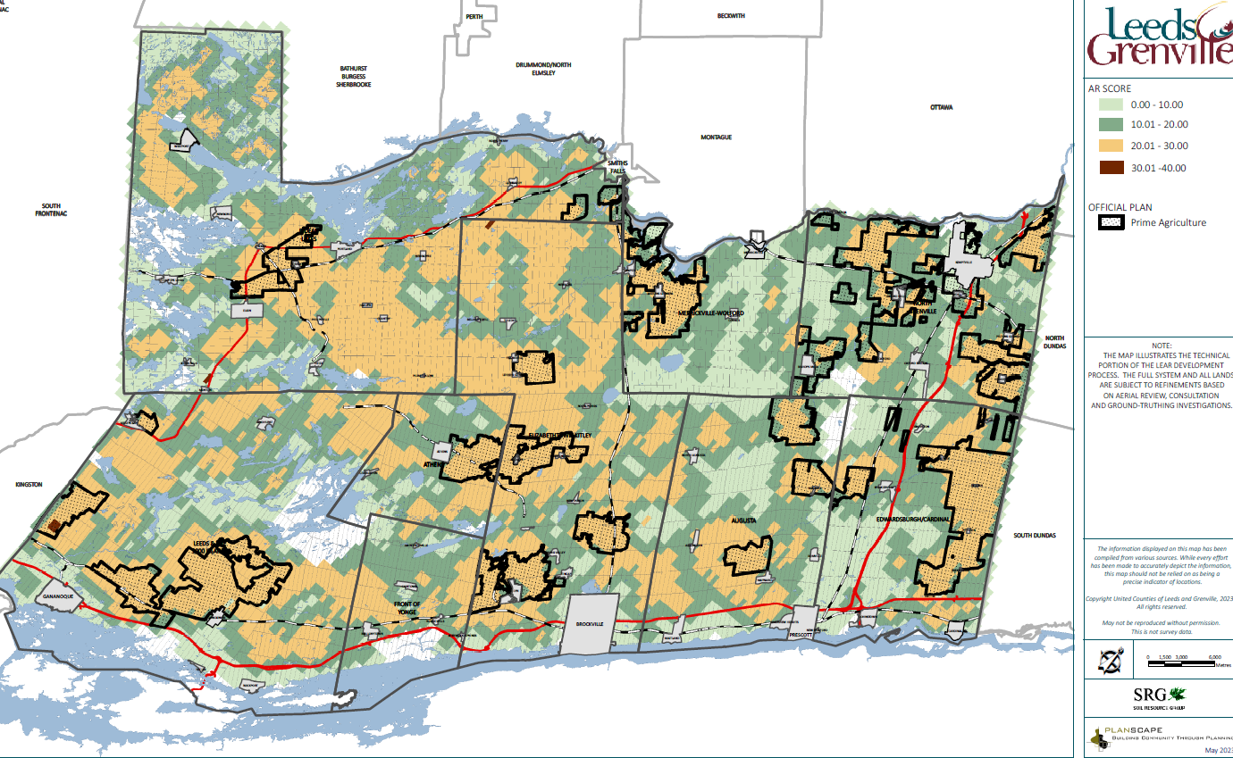
AR Components of the LEAR
Two factors were identified for the Counties of Leeds and Grenville.
Fragmentation
Lands in agricultural production

Slide 12
Weighting the LEAR Factors
Soils (Canada Land Inventory Soil Capability for Agriculture) (LE Factor) – 60%
Fragmentation (AR Factor) – 10%
Percentage of Land in Agricultural Production (AR Factor) – 30%
The weightings match the OMAFRA methodology.

Slide 13
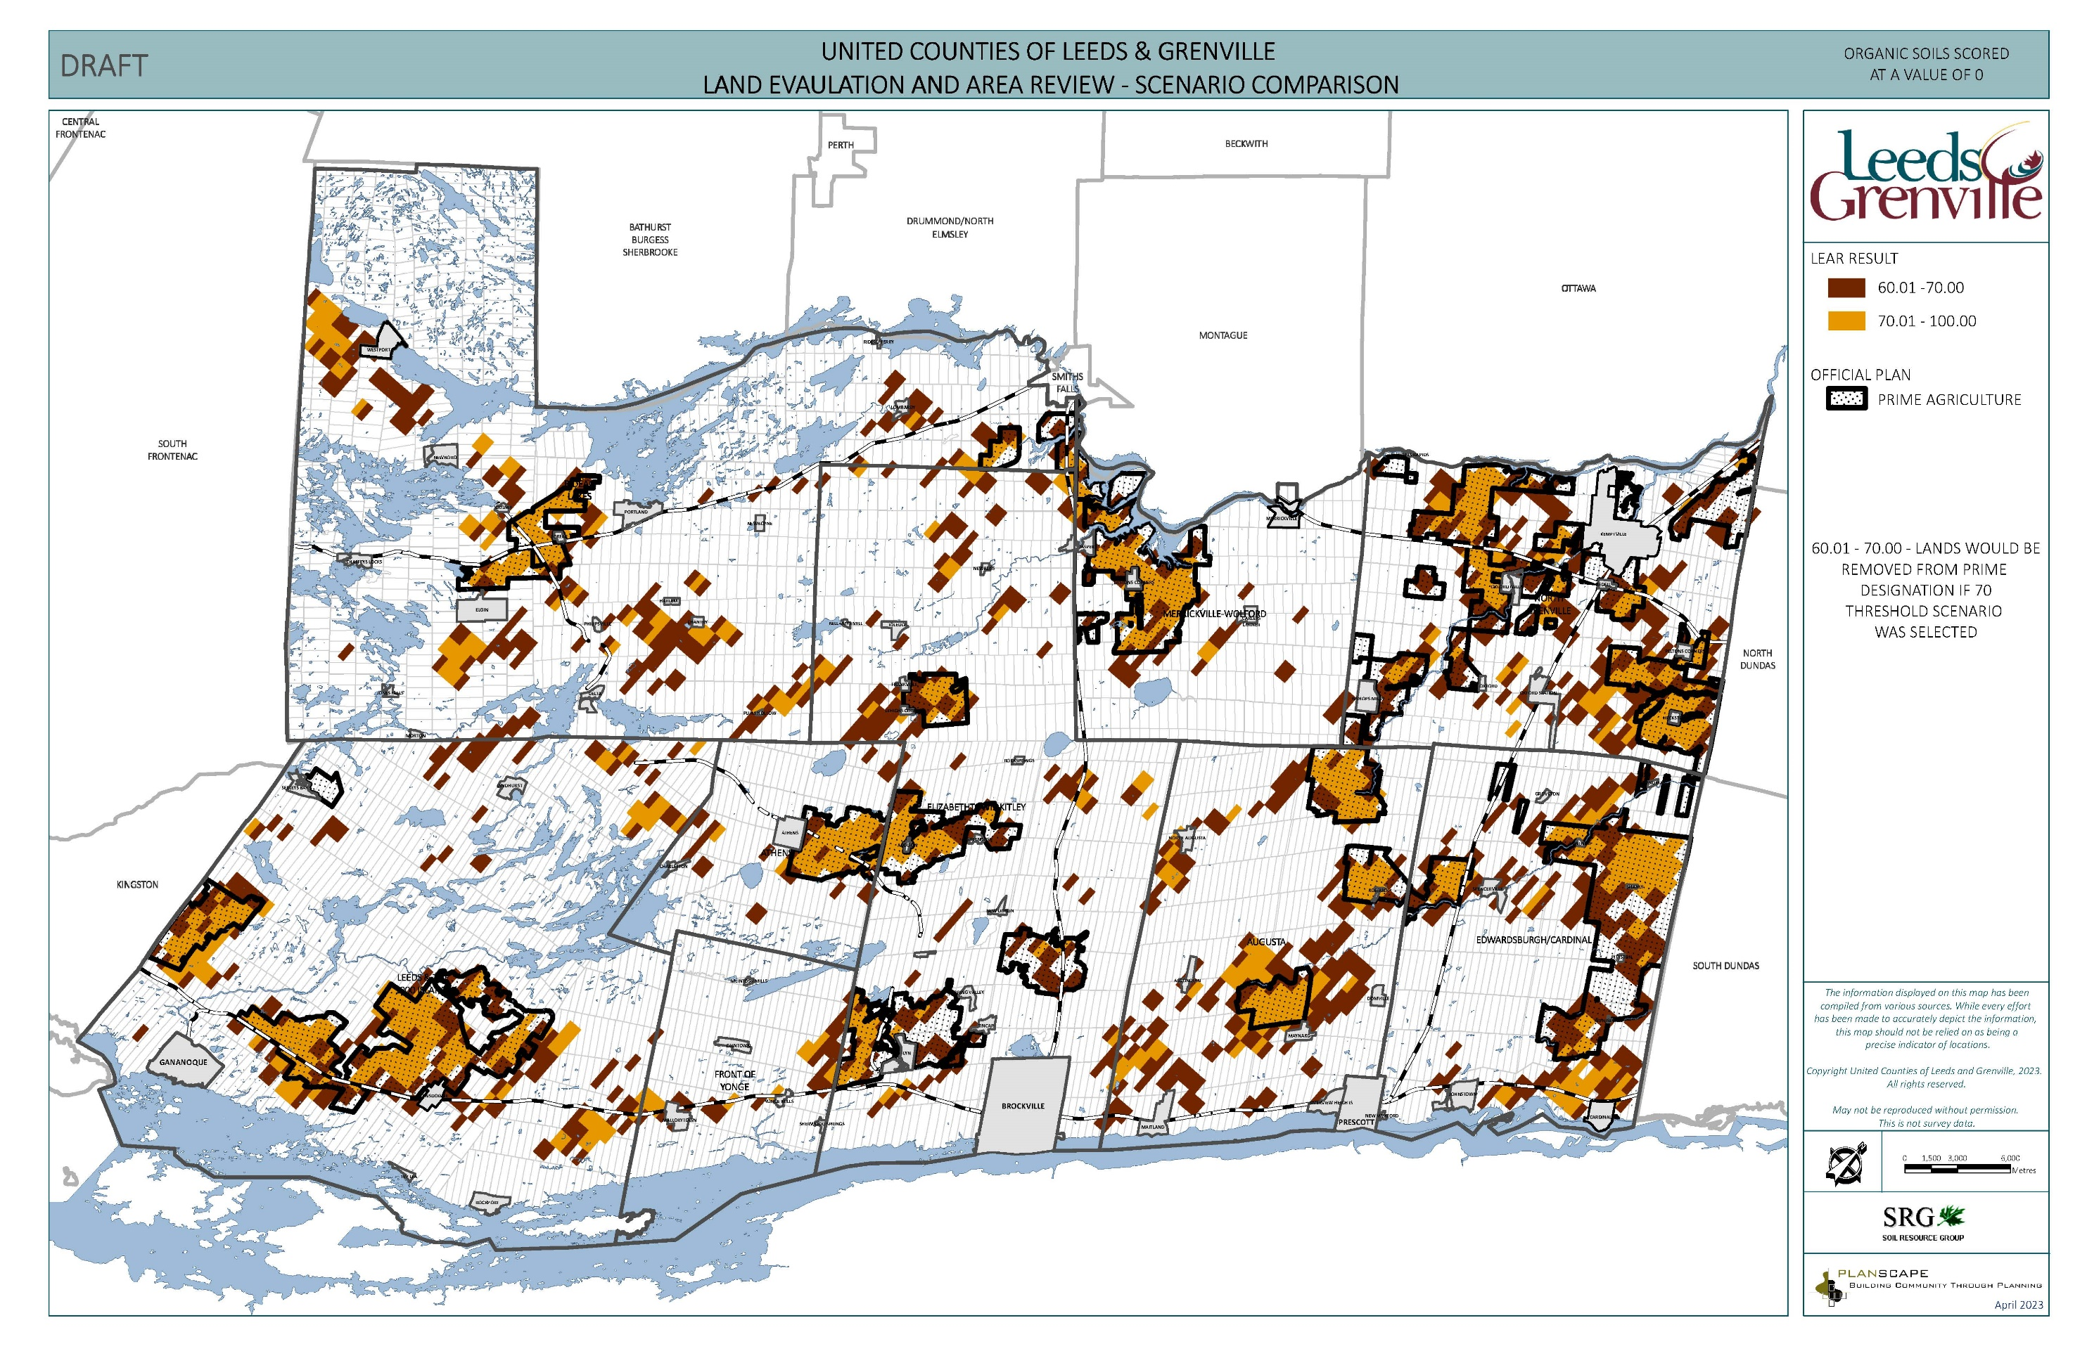
Selecting the Scoring Threshold
The scoring threshold of 60 (out of 100) was selected.
The OMAFRA guideline suggests testing both the 60 and 70 threshold scores
Applying the 70 threshold would result in significant removal of land from the existing designated prime lands.
Notes:
The currently designated prime agriculture areas have proven to be predominately both Class 1-3 soils and lands which are currently farmed.
Selecting a scoring threshold of 70 would have precluded around 18,000 ha of lands. Given the relatively low availability of class 1 – 3 lands, it was determined that the 60 score was most appropriate to use to eliminate lands from the final system.
The scores are used to reference areas through the rounding and refinement process.

Slide 14
DRAFT LEAR MAP
The Gold coloured areas are the lands identified by the LEAR

Slide 15
LEAR Map Confirmations / Next Steps
We will apply the input we have heard to date (page 22 of report) and consult on the draft maps, using the following template for feedback and welcoming all input.
The Counties has created this table as an electronic survey that is returning responses.

Slide 16
LEAR Map Confirmations / Next Steps
The draft report was circulated to the public via social media, news release, ads in the newspaper and use of municipal communication channels. Agencies and all interested parties were notified directly.
We have received approximately 25 individual responses since releasing the draft LEAR map in addition to the feedback we heard in the first step of the project.
The feedback will be used (and tracked) to refine the final LEAR map.
On June 22, site visits will continue to investigate properties that require in-person confirmation.
A refinement process that identifies isolated areas and edge rounding is already underway. Comments on the Draft LEAR map (released May 16 and presented today) are due June 30, 2023.
The consultation process on the refined mapping will continue through the summer to allow stakeholders time to provide specific comment.
A final system map will be available in the fall of 2023 for a final consultation and the statutory public meeting for the Official Plan Amendment (the intent is for the required public meeting to be held in October).

Slide 17
Figure 12: Municipality of North Grenville LEAR Map

Slide 18
Figure 13: Township of Rideau Lakes LEAR Map

Slide 19
Figure 14: Township of Elizabethtown-Kitley LEAR Map

Slide 20
Figure 15: Township of Leeds and the Thousand Islands LEAR Map

Slide 21
Figure 16: Township of Augusta LEAR Map

Slide 22
Figure 17: Township of Edwardsburgh/Cardinal LEAR Map

Slide 23
Figure 18: Village of Merrickville–Wolford LEAR Map

Slide 24
Figure 19: Township of Athens LEAR Map

Slide 25
Figure 21: Township of Front of Yonge LEAR Map

Slide 26
Thank you for attending!
Please contact the project team by phone or email if you have questions, concerns or suggestions regarding this project.
Elaine Mallory, Planner 1
613-342-3840, ext. 2422
elaine.mallory@uclg.on.ca

Slide 27
LEAR Process
Land Evaluation and Area Review (LEAR) Process
Selecting an Evaluation Unit Size
Calculating the Land Evaluation (LE) Component
  Land Evaluation Calculation
Establishing the Area Review (AR) Factors of the LEAR
Area Review (AR) Factors Procedure
Weighting the Factors of a LEAR
Land Evaluation (LE) and Area Review (AR) Mapping
Selecting the Threshold Score Through Scenario Comparison
Key considerations / conclusions with the LE analysis:
Class | Acres | Hectares | Percent
Class 1 | 973 | 394 | 0.12% | 30%
Class 2 | 145,541 | 58,898 | 17.58%
Class 3 | 99,961 | 40,453 | 12.08%
Class 4 | 61,399 | 24,847 | 7.42% | 70%
Class 5 | 59,819 | 24,208 | 7.23%
Class 6 | 250,679 | 101,446 | 30.28%
Class 7 | 122,400 | 49,533 | 14.79%
Organic Soils | 85,482 | 34,593 | 10.33%
Total Lands | 827,823 | 335,008 | 100%

