Slide 1

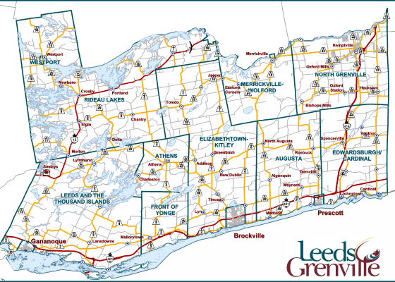

Planning Advisory Committee (PAC)
Draft Recommended Agricultural System Map for Planning Advisory Committee Meeting
September 6, 2023 at 9:00a.m.
Notes:
Line spacing + Page numbers

Slide 2
Agenda
Overview of project process
Review of Refinement Procedure
Statistical summaries by municipality
Next Steps

Slide 3

Project Purpose
What we know from the recent legislative changes, as well as the draft changes to the PPS, is that an agricultural systems approach is the recommended method for identifying and protecting agricultural lands into the future.
Should more permissive severance policies ultimately be adopted, this system is still a valuable tool to use to protect agricultural resources through policy and zoning.
To satisfy the provincial requirement to identify and designate prime agricultural areas in the Counties in advance of the next OP through a modified LEAR process.
The result of a LEAR process is a map of the County agricultural system that represents lands that are viable for agriculture and emphasize the importance of creating a system wherever possible.

Slide 4
Overview of Project Process
November 2022 – February 2023
November 2022 – April 2023
April 2023 – October 2023
Stage 1
Stage 2
Stage 3
Project Introduction
Introduce the project to the public, Advisory Group and all stakeholders to review workplan, timing and deliverables.
Feedback sought on any additional information sources.
Technical Analysis
Undertake a modified LEAR methodology to rank the lands (more on this later)
A draft LEAR map was produced with a methodology report and consulted on with stakeholders (public and agricultural community.
Consultation on the LEAR mapping was undertaken through public posting, a public meeting in June, and a public survey to solicit feedback. The methodology report explaining the LEAR process was also provided.
Recommended System
Feedback was individually tracked, considered and will be responded to.
An in-depth refinement process was undertaken that considered feedback heard from the consultation process.
A refinement standardization process was developed with a refinement code table to ensure the refinement consistency and transparency.
The refinement process and maps have been provided to municipal staff of all member municipalities as well as interested OFA members to support the refinement map review process.
Final refinements will be made following this meeting and the recommended system will be posted for final public comment.
The Recommended System in the form of an Official Plan Amendment will be presented to Council at a Statutory Public Meeting.
A final report with technical appendices will be provided to the Counties to wrap up the project.
November 2023
Project Completion

Slide 5
Consultation Process
Continuous and responsive consultation has taken place throughout the project through a coordinated effort with Counties staff and Planscape.
The following formal meetings have taken place to date:
  December 12, 2022 Public Open House and Technical Advisory Group (TAG)
  January 4, 2023 Planning Advisory Committee (PAC)
  March 3, 2023 Grenville Federation of Agriculture
  March 24, 2023 Leeds Federation of Agriculture
  May 11, 2023 TAG
  May 25, 2023 PAC
  June 21, 2023 Public Information Session
  June 22, 2023 Site Visits with interested parties
  August 1 – 16, 2023 Distribution of refined maps to local municipalities
  August 23, 2023 Leeds Federation of Agriculture
  August 29, 2023 Grenville Federation of Agriculture (cancelled due to lack of interest/availability)
  August 31, 2023 TAG
  September 6, 2023 PAC
  November 2023 – anticipated timing of Statutory Public Meeting

Slide 6
Refinement Procedure
A structured approach was taken for making the map refinements. The process aimed to create consistent priorities for refinement of decision-making that respects the provincial LEAR process, the fundamental integrity of an agricultural system and the feedback received throughout the process.
Factors considered for each refinement are:
Exclude isolated lands scoring 60 or more.
Include current Official Plan prime agricultural designation areas except where edge refinements clip to an identifiable boundary or to avoid an identifiable natural heritage feature that are more appropriate.
Lands that are actively farmed but scored below the 60-score threshold are generally NOT included in the prime agricultural area except where they serve to create a boundary refinement. For example, if the 60 scoring land cuts through an actively farmed field, the refinement will move the edge of the boundary to the edge of the field or property line, rather than bisect an actively farmed field.
Exclude identifiable natural heritage features such as a woodlots or wetlands where possible. Where the feature is located centrally in a contiguous agricultural area, it will be kept as part of the system (as removing it would compromise the larger system base).
Existing fragmentation has been refined out along road frontages where it is appropriate to use the road as the agricultural system boundary.
At the request of landowners, where appropriate, lands have been included that do not meet the 60-score threshold. An example of this are Community Pasture lands that do not meet the scoring threshold but provide an important component of the agricultural system. It is recognized that the LEAR methodology does not sufficiently represent the value of these lands, so they have been included where a property owner has requested that they be identified in the prime agricultural designation.

Slide 7
Refinement Codes
Refinement Code | Refinement Circumstance / Description
Ref – 1 | To extend Prime Agricultural Lands over lower scoring land to establish the agricultural system as defined by the province
Ref – 2 | To account for active production or agricultural investment that scores less than 60
Ref – 3 | To refine Prime Agricultural Lands to an identifiable boundary
Ref – 4 | To create a continuous agricultural land base across municipal jurisdictional boundaries
Ref – 5 | To reflect pre-existing non-agricultural designations or uses
Ref – 6 | To reflect land that is primarily Natural Heritage System – limited or no agricultural production is occurring
Ref – 7 | To include lands at an owner’s request
Ref – 8 | To include lands scoring greater than 60
Ref – 9 | To exclude parcels that are isolated from other agricultural lands or operations
Ref – 10 | To exclude lands with conflicting land uses
Ref – 11 | To exclude areas subject to significant fragmentation
Ref – 12 | Refinement as a result of local area municipal staff, agency, or stakeholder request
For ease of identification on the refinement maps, refinement codes were created as a labelling system.
The most applicable code is noted next to each refinement, but it is important to understand that there is very often more than one reason for the refinement.
The codes have been created to facilitate stakeholder understanding of the rationale behind the refinement but are not intended to be a complete explanation.
There is professional judgement, stakeholder input and multi-faceted criteria that were applied for every refinement in the system.

Slide 8
Draft Recommended System

Slide 9
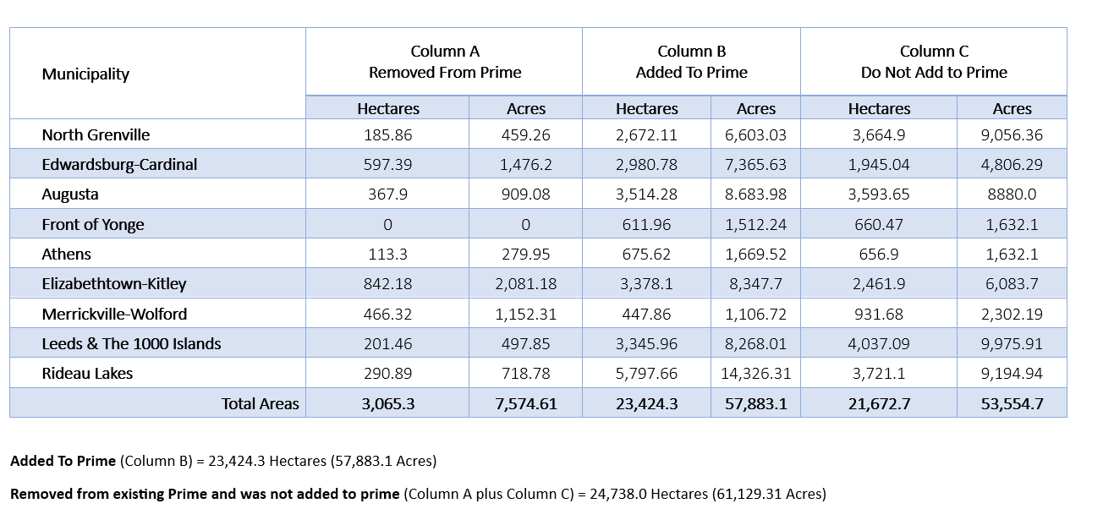
Summary of Lands Added and Removed
Column C
Considered, Not Added to Prime

Slide 10
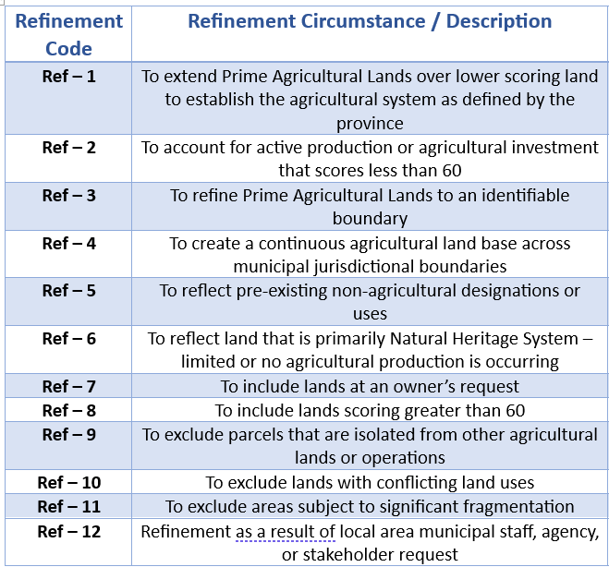
Refinement Example – Hyndman Road

Slide 11
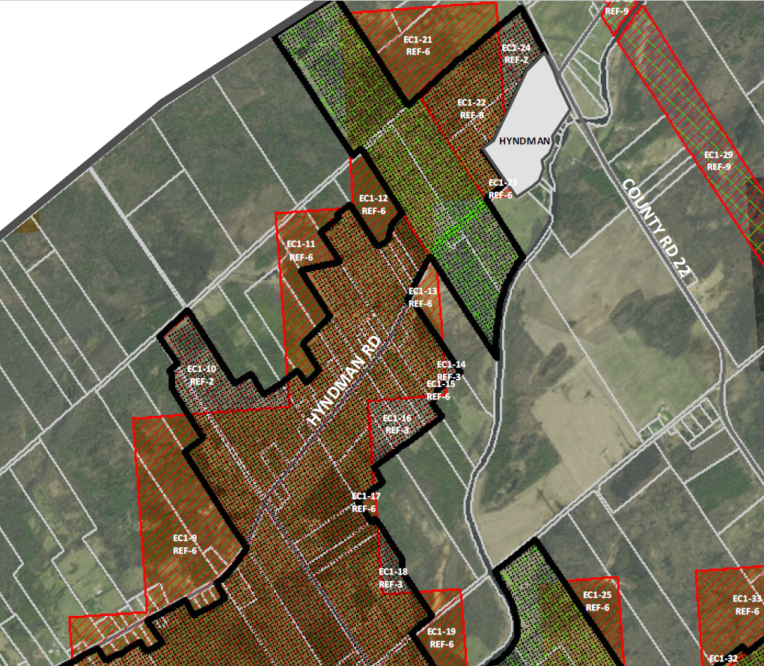
Refinement Example – Hyndman Road
EC1 – 21: means Edwardsburg-Cardinal Map 1, Refinement 21
EC1-21 REF-6: means that this refinement was primarily made to remove areas that have significant Natural Heritage Features.
EC1-16 REF 3: to refine the lands to an identifiable boundary (road, field, parcel fabric, wood lot)
EC1-29 REF 9: to exclude isolated lands scoring above 60

Slide 12
Draft Recommended System

Slide 13
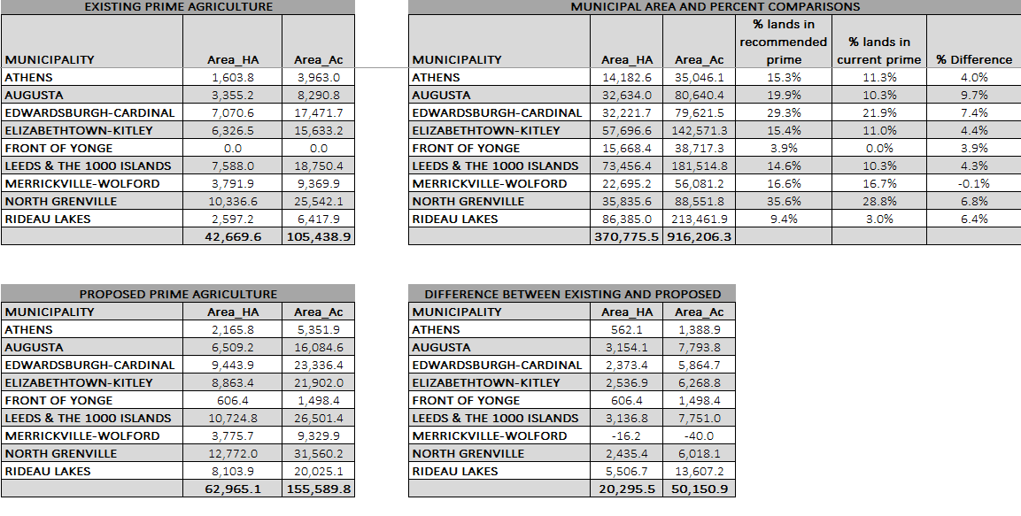
System Statistics

Slide 14
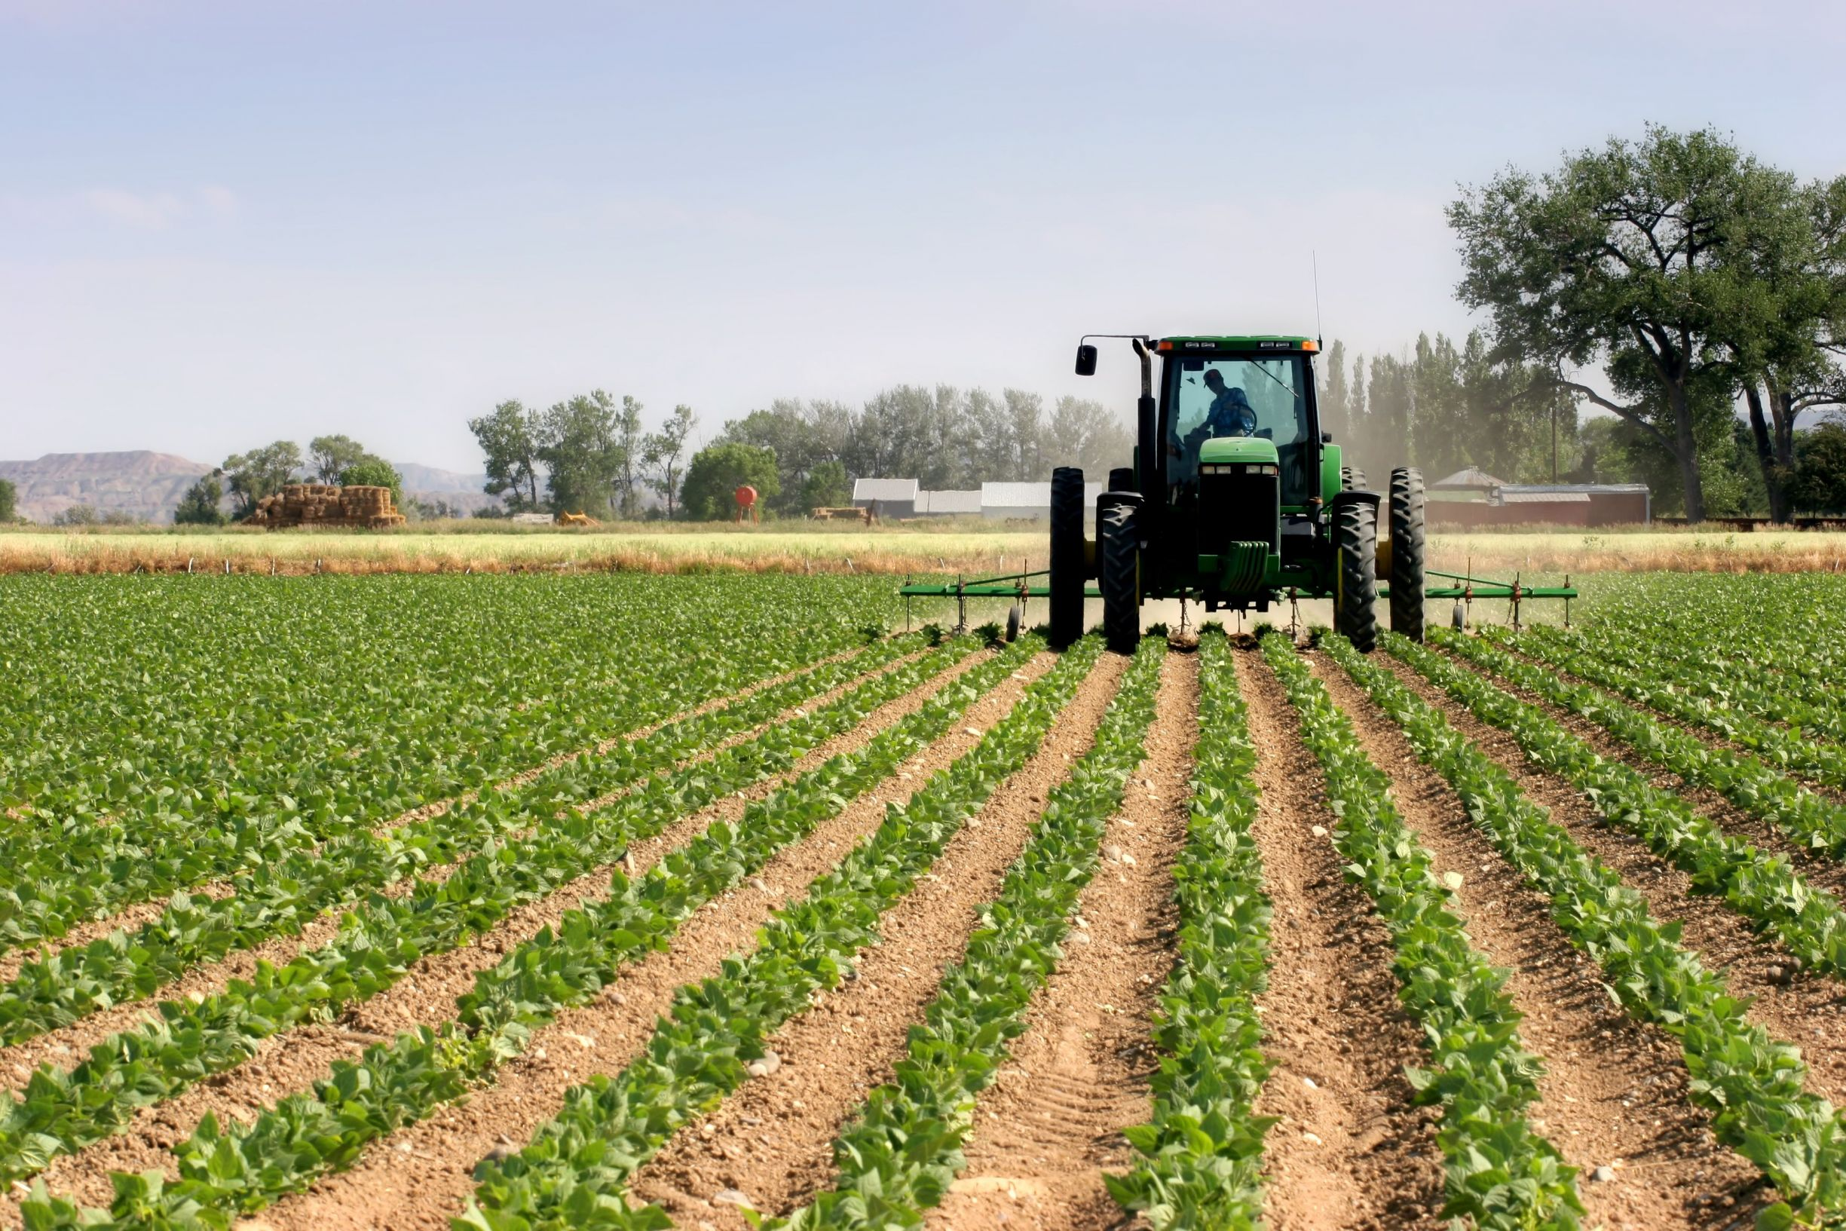
Next Steps
Make refinements provided by municipalities, OFAs, the public and PAC (from the last several weeks of consultation)
Post the Recommended Agricultural System for all stakeholders to have a final review until end of September
Advertise for the Statutory Public Meeting
Finalize the Recommendations Report and make any final adjustments to the system map
Present the Recommended Agricultural System to the public and Council at a public meeting
Obtain Council endorsement of System

Slide 15
Thank you for attending!
Please contact the project team by phone or email if you have questions, concerns or suggestions regarding this project.
Elaine Mallory, Planner 1
613-342-3840, ext. 2422
elaine.mallory@uclg.on.ca

